Slide 1

Donar Me: An application for Managing Blood and Organ Donation in Sri Lanka
2022_311

Slide 2
Overall Project Description

Slide 3
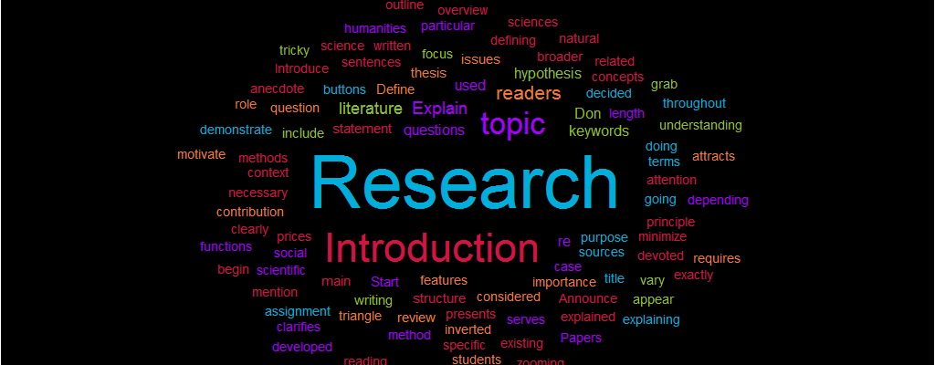
Introduction
In Sri Lanka, all communication between blood and organ donors, banks and recipients are currently done physically with no standardized web or software-based management system
Introducing a software base management system can increase the efficient

Slide 4

Research Question
How to access relaibale national data related blood?
How to use an application to reach a larger crowd?
Many medical comparisons are conducted between the donor and the donee in an Orgon transplant, how is this procedure activated through an application?
How to ensure registered donors’ privacy ?

Slide 5
Objectives
Main Objective
Design and develop an application to manage blood and organ donations in Sri Lanka Using NLP, Indexing technique, Google map API, Real time messaging, Image Processing
Sub Objectives
Design and develop a component to Predict future blood usage using gathering and analyzing of anonymous data
Design and develop a component to manage the blood donation camps effectively
Design and Develop the component to Create a successful correspondence in between the donors and the done
Design and Develop the component to manage the connection between blood bank and donors according to the needs and managing passbook

Slide 6
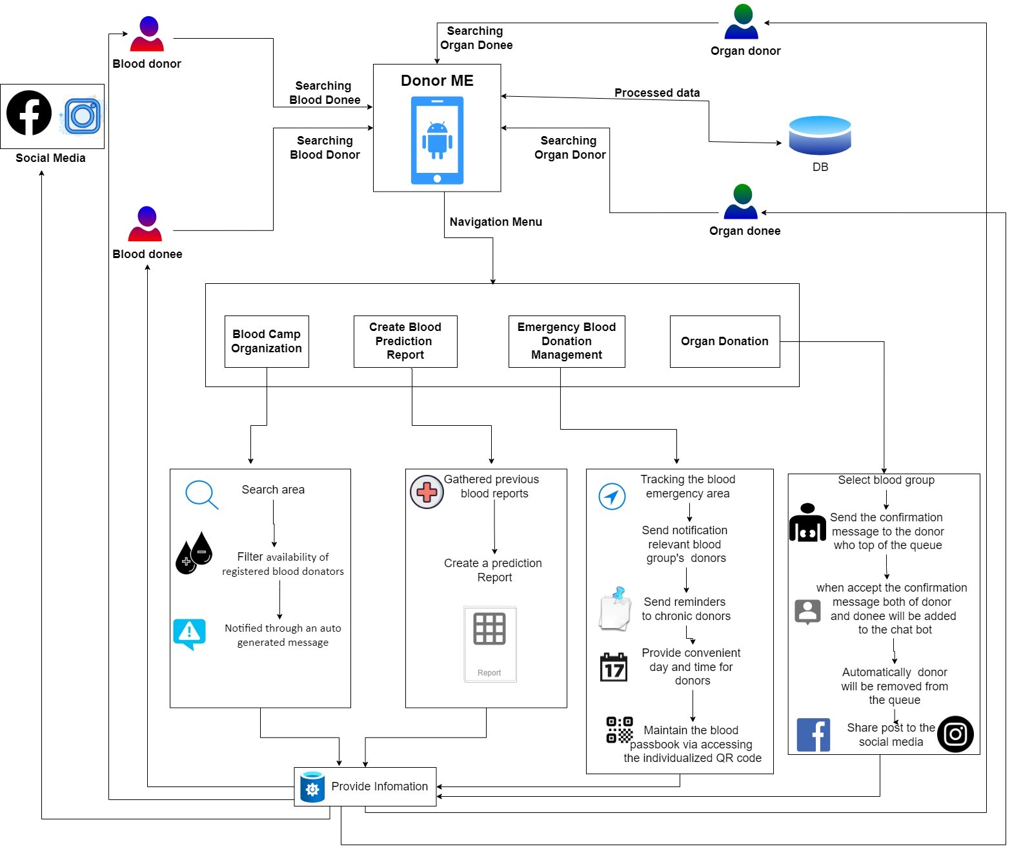
Overall System Diagram

Slide 7
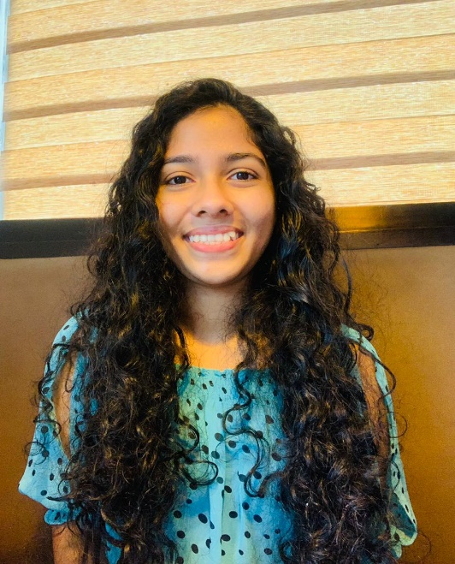
IT19121734 | R.M.S. Dananjani
Specialization in Information Technology
IT19121734 | R.M.S.Dananjani
2022_311

Slide 8

Introduction
The Prediction Of Blood For The Future Use
IT19121734 | R.M.S.Dananjani
2022_311

Slide 9
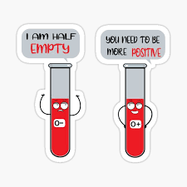
Background
The amount of Blood needed for each Hospital by the Blood bank is predicted by the System.
In which Times, selected Hospitals need more Blood than Regular months
For A selected Hospital, the most and least wanted Blood Groups are predicted
IT19121734 | R.M.S.Dananjani
2022_311

Slide 10
Research Gap
IT19121734 | R.M.S.Dananjani
2022_311

Slide 11

Research Question
Deficiency of future accessibility of blood and lack of prediction?
IT19121734 | R.M.S.Dananjani
2022_311

Slide 12
Specific and Sub Objectives
Specific Objectives
The Prediction of blood for the future use.
Sub Objectives
Send auto-generated message
Locate the nearest blood donation camp
Show the map to the user
IT19121734 | R.M.S.Dananjani
2022_311

Slide 13

Research Methodology
IT19121734 | R.M.S.Dananjani
2022_311

Slide 14
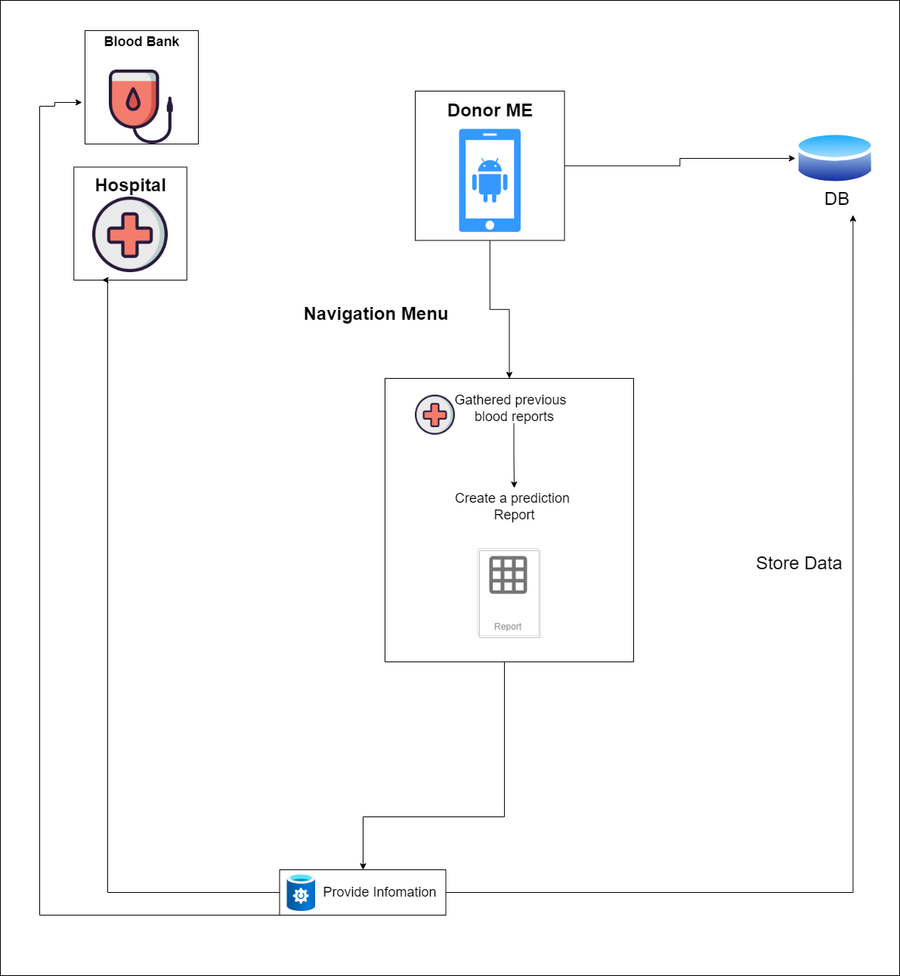
System Diagram
IT19121734 | R.M.S.Dananjani
2022_311

Slide 15

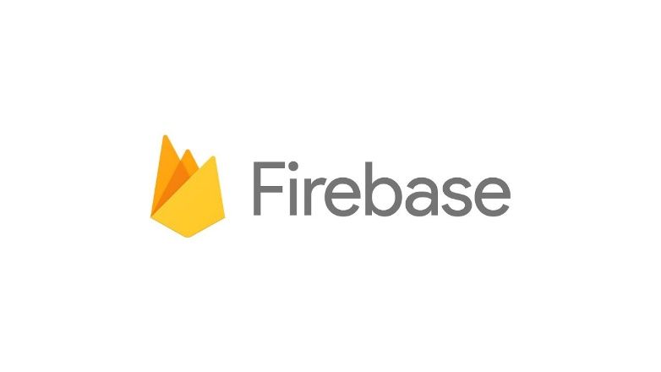
Technologies
Programming Language
Python, JavaScript
Libraries
Firebase
IT19121734 | R.M.S.Dananjani
2022_311

Slide 16
Requirements
User Requirements
System requirements (For implementation)
IT19121734 | R.M.S.Dananjani
2022_311

Slide 17
Requirements contd..
Software Specific Requirements
Functional
Non functional
IT19121734 | R.M.S.Dananjani
2022_311

Slide 18
Work Breakdown Structure
IT19121734 | R.M.S.Dananjani
2022_311

Slide 19
Supportive information
IT19121734 | R.M.S.Dananjani
2022_311

Slide 20
Commercialization
User benefits
Minimize the wastage of blood
Be prepared for the respective time periods(Both Hospital and Blood Bank)
Suggesting industries
This supports both blood bank and Hospital in saving time
Increasing the productivity
IT19121734 | R.M.S.Dananjani
2022_311

Slide 21
References
IT19121734 | R.M.S.Dananjani
2022_311

Slide 22
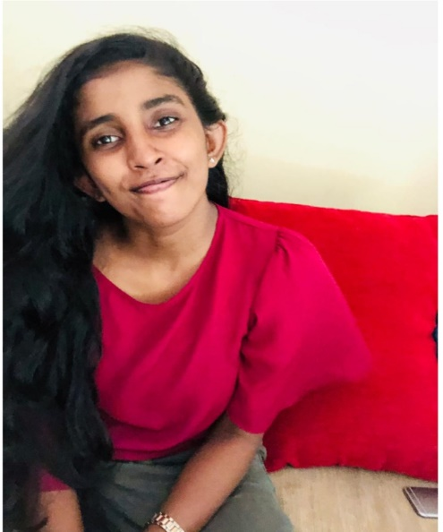
IT19112992 | B.N.Dullewa
Specializing of Information Technology
IT19112992 | B.N.Dullewa
2022_311

Slide 23

Introduction
Manage The Blood Donation Camps Effectively
IT19112992 | B.N.Dullewa
2022_311
IT18217100 | Dilshan H.V.V

Slide 24
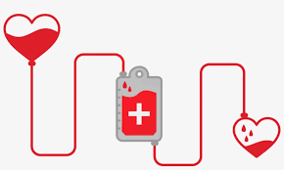
Background
Select the proper location to hold the blood donation camp
The current availability of registered blood donators detected in the respective blood donation camp’s area
The potential donors will be notified through an auto-generated message
Locate the nearest blood donation camp and the camps which are to be held in the future
IT19112992 | B.N.Dullewa
2022_311
IT18217100 | Dilshan H.V.V

Slide 25
Research Gap
Select proper locations to hold blood donation camp
Send notifications to users
Locate the nearest blood donation camp
Research | Select proper locations to hold blood donation camp | Send notifications to users | Locate the nearest blood donation camp
Research[1] | Yes | No | No
Research[2] | No | No | No
Research[3] | No | No | No
Proposed System | Yes | Yes | Yes
IT19112992 | B.N.Dullewa
2022_311

Slide 26

Research Question
How to locate the nearest blood donation camp ?
How to notified through an auto-generated message The potential donors ?
How to identify suitable location to hold a blood donation camp?
How do we manage to keep donor details confidentially?
IT19112992 | B.N.Dullewa
2022_311
IT18217100 | Dilshan H.V.V

Slide 27
Specific and Sub Objectives
Specific Objectives
Select the proper location to hold the blood donation camp
Sub Objectives
The amount of Blood needed for each Hospital by the Blood bank is predicted by the System
In which Times, selected Hospitals need more Blood than Regular months
For A selected Hospital, the most and least wanted Blood Groups are predicted
IT19112992 | B.N.Dullewa
2022_311
IT18217100 | Dilshan H.V.V

Slide 28

Research Methodology
IT19112992 | B.N.Dullewa
2022_311
IT18217100 | Dilshan H.V.V

Slide 29
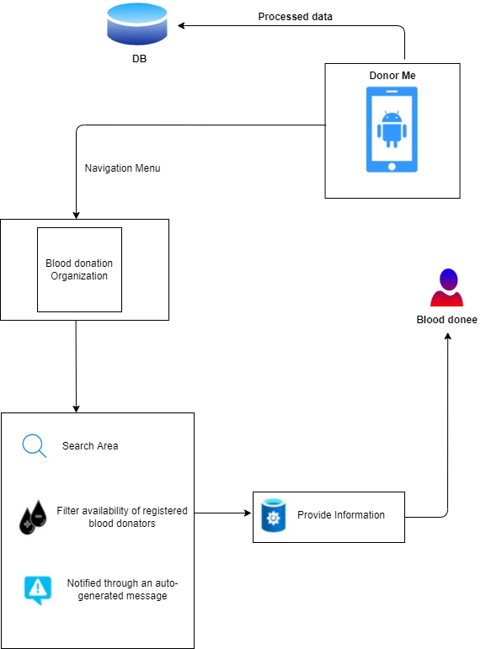
System Diagram
IT18217100 | Dilshan H.V.V
2022_311
IT19112992 | B.N.Dullewa

Slide 30

Technologies
Programming Language
Python, JavaScript
Libraries
Firebase
IT19112992 | B.N.Dullewa
2022_311
IT18217100 | Dilshan H.V.V

Slide 31
Requirements
User Requirements
System requirements (For implementation)
IT19112992 | B.N.Dullewa
2022_311
IT18217100 | Dilshan H.V.V

Slide 32
Requirements contd..
Software Specific Requirements
Functional
Non functional
IT19112992 | B.N.Dullewa
2022_311

Slide 33
Work Breakdown Structure
IT19112992 | B.N.Dullewa
2022_311
IT18217100 | Dilshan H.V.V

Slide 34
Supportive information
IT19112992 | B.N.Dullewa
2022_311
IT18217100 | Dilshan H.V.V

Slide 35
Commercialization
User benefits
If a person need to organized a blood camp, she/he can choose a location through this application
Registered blood donors can get notified nearest blood camp information
Recruits new donors
Suggesting industries
This supports people in saving time
Increasing the productivity
IT19112992 | B.N.Dullewa
2022_311
IT18217100 | Dilshan H.V.V

Slide 36
References
IT19112992 | B.N.Dullewa
2022_311
IT18217100 | Dilshan H.V.V

Slide 37
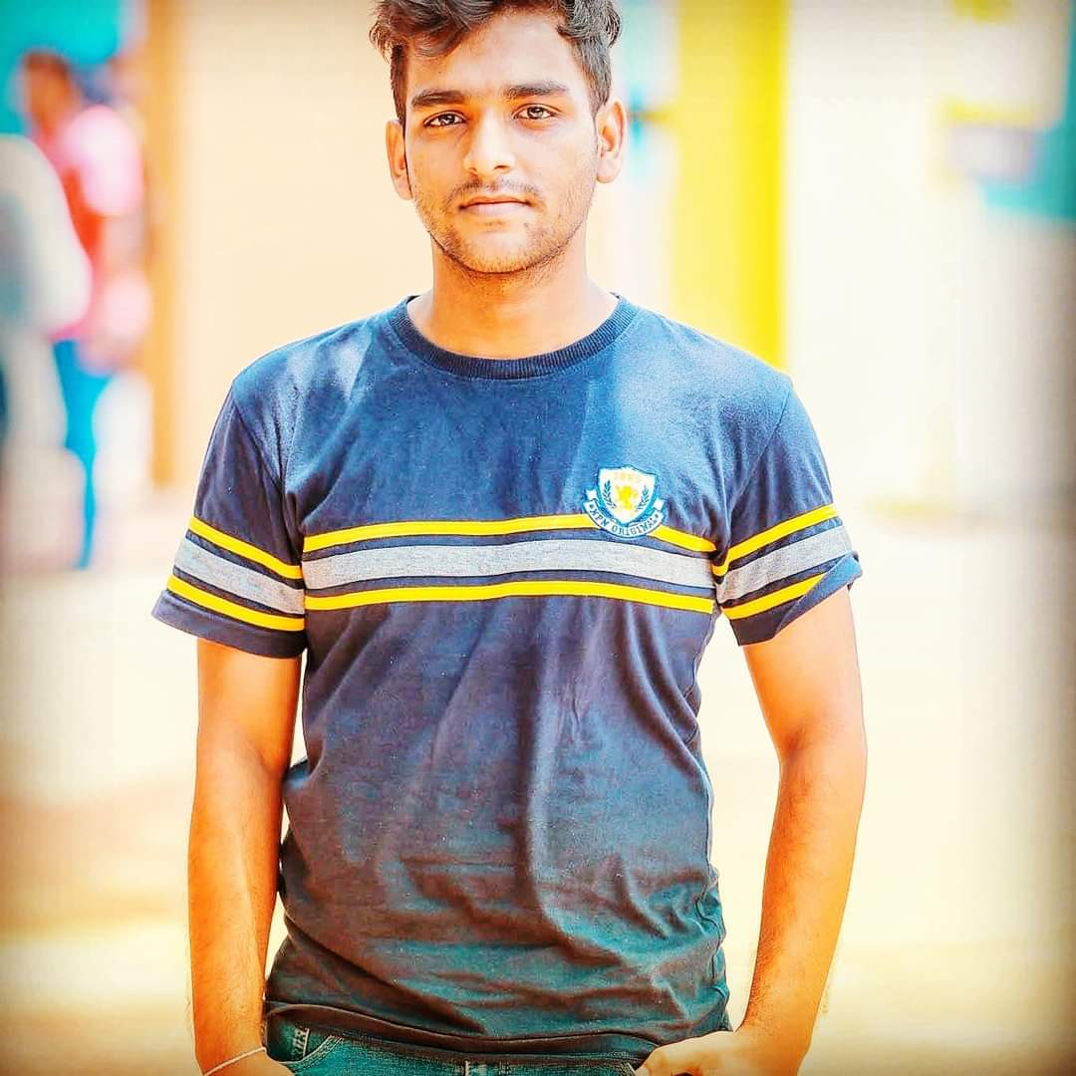
IT19236438| K.U.R.O.D Bandara
Specialization of Information Technology
IT19236438| K.U.R.O.D.Bandara
2022_311

Slide 38

Introduction
Create A Successful Correspondence In Between The Donors And The Donees
IT19236438| K.U.R.O.D.Bandara
2022_311

Slide 39
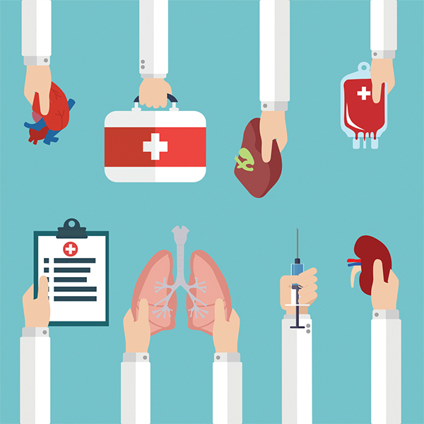
Background
Create a successful correspondence between the donors and the donees
IT19236438| K.U.R.O.D.Bandara
2022_311

Slide 40
Research Gap
Store Donors in a queue in order of registration.
• Send confirmation message to the donor.
• Chatbot and real-time Message
• Share the post to social media
Research | Store Donors in a queue in order of registration | Send confirmation message to the donor | Chatbot and real-time Message | Share the post to social media
Research[1] | Yes | No | No | No
Research[2] | No | No | No | Yes
Research[3] | No | No | No | No
Proposed System | Yes | Yes | Yes | Yes
IT19236438| K.U.R.O.D.Bandara
2022_311
IT18220834 | WIJETHILAKA R.G.K.H

Slide 41

Research Question
How to Store Donors in a queue in order of registration?
How to Send a confirmation message to the donor by filtering the first donor in the queue?
How to create a Chatbot and real-time Message?
How to create and share the post on social media?
IT19236438| K.U.R.O.D.Bandara
2022_311
IT18220834 | WIJETHILAKA R.G.K.H

Slide 42
Specific and Sub Objectives
Specific Objectives
Create a successful correspondence between the donors and the donees
Sub Objectives
Send confirmation message to the donor
Chatbot and real-time Message
Create and Share the post on social media
IT19236438| K.U.R.O.D.Bandara
2022_311
IT18220834 | WIJETHILAKA R.G.K.H

Slide 43
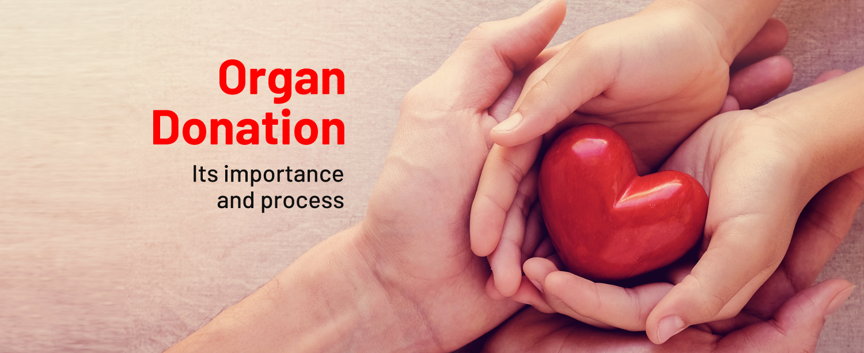
Research Methodology
IT19236438| K.U.R.O.D.Bandara
2022_311
IT18220834 | WIJETHILAKA R.G.K.H

Slide 44
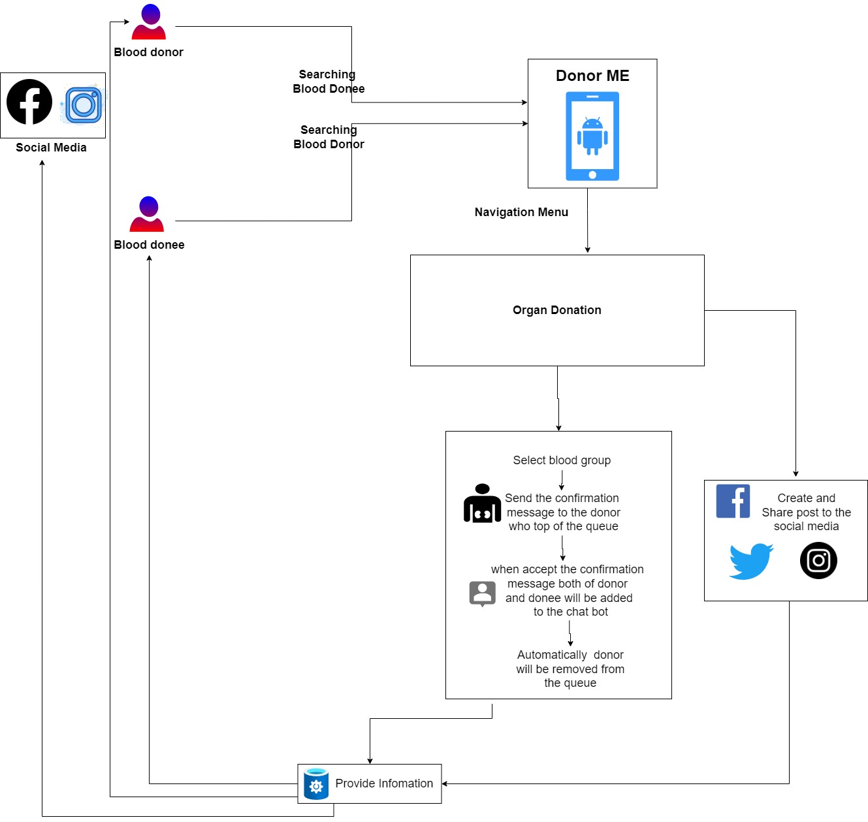
System Diagram
IT19236438| K.U.R.O.D.Bandara
2022_311

Slide 45

Technologies
Programming Language
Python, JavaScript
Libraries
Firebase
IT19236438| K.U.R.O.D.Bandara
2022_311

Slide 46
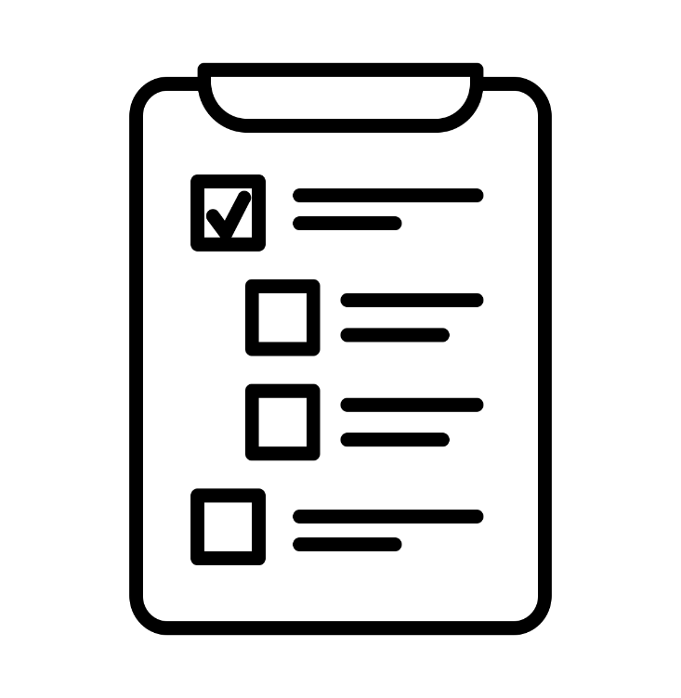
Requirements
User Requirements
Need to send a confirmation message to the donor
Should create a chatbot by adding the donor who responded and the donee
Need to get permission to Create and Share the post on social media
System requirements (For implementation)
IT19236438| K.U.R.O.D.Bandara
2022_311
IT18220834 | WIJETHILAKA R.G.K.H

Slide 47
Requirements contd..
Software Specific Requirements
Functional
Login
Registration
Send a confirmation message to the donor
Create a chatbot by adding the donor who responded and the donee
Create and Share the post on social media
Non functional
IT19236438| K.U.R.O.D.Bandara
2022_311
IT18220834 | WIJETHILAKA R.G.K.H

Slide 48
Work Breakdown Structure
IT19236438| K.U.R.O.D.Bandara
2022_311

Slide 49
Supportive information
IT19236438| K.U.R.O.D.Bandara
IT19236438| K.U.R.O.D.Bandara
2022_311
IT18220834 | WIJETHILAKA R.G.K.H

Slide 50
Commercialization
User benefits
In case of need of an organ, can easily find a donor
Since it is possible to create a chatbot donee can directly get the information from the donor
Suggesting industries
IT19236438| K.U.R.O.D.Bandara
2022_311
IT18220834 | WIJETHILAKA R.G.K.H

Slide 51
References
IT19236438| K.U.R.O.D.Bandara
2022_311
IT18220834 | WIJETHILAKA R.G.K.H

Slide 52
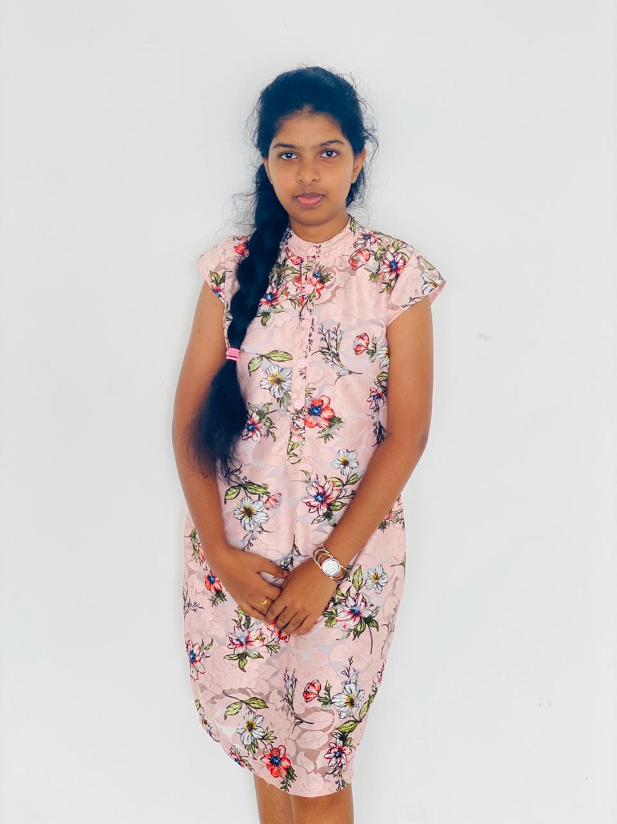
IT19115108 | Malkanthi.P.L
Specialization In Information Technology
IT19115108 | Malkanthi.P.L
2022_311

Slide 53

Introduction
Emergency Blood Donation Management & Managing Online Passbook
IT19115108 | Malkanthi.P.L
2022_311
IT18212150 | T.D. BALASOORIYA

Slide 54

Background
Many researchers have done different researches on blood donation.
Manage the connection between blood bank and donors according to the needs
IT19115108 | Malkanthi.P.L
2022_311
IT18212150 | T.D. BALASOORIYA

Slide 55
Research Gap
Live tracking donors via GPS
Filtering eligible donors (blood group, chronic donor, nearby location)
Automatically detect the chronic donors & send reminders
Provide individualized QR code
Provide online passbook
Research | Live tracking donors via GPS | Filtering eligible donors | Automatically detect the chronic donors & send reminders | Provide individualized QR code | Provide online passbook
Research[1] | No | No | No | No | No
Research[2] | Yes | No | No | No | No
Research[3] | No | No | No | No | No
Research[4] | No | No | No | No | No
Proposed System | Yes | Yes | Yes | Yes | Yes
IT19115108 | Malkanthi.P.L
2022_311
IT18212150 | T.D. BALASOORIYA

Slide 56

Research Question
How to generate QR code?
How to send messages by filtering eligible donors?
How to develop a user-friendly application?
How to tracking donors using google map?
IT19115108 | Malkanthi.P.L
2022_311
IT18212150 | T.D. BALASOORIYA

Slide 57
Specific and Sub Objectives
Specific Objectives
Manage the communication between the blood bank and the donors in accordance with their requirements.
Sub Objectives
Provide an individualized QR code
Provide an online passbook
Send notifications to the registered eligible donors, by using google map
Send reminders to the chronic blood donors
IT19115108 | Malkanthi.P.L
2022_311
IT18212150 | T.D. BALASOORIYA

Slide 58

Research Methodology
IT19115108 | Malkanthi.P.L
2022_311
IT18212150 | T.D. BALASOORIYA

Slide 59
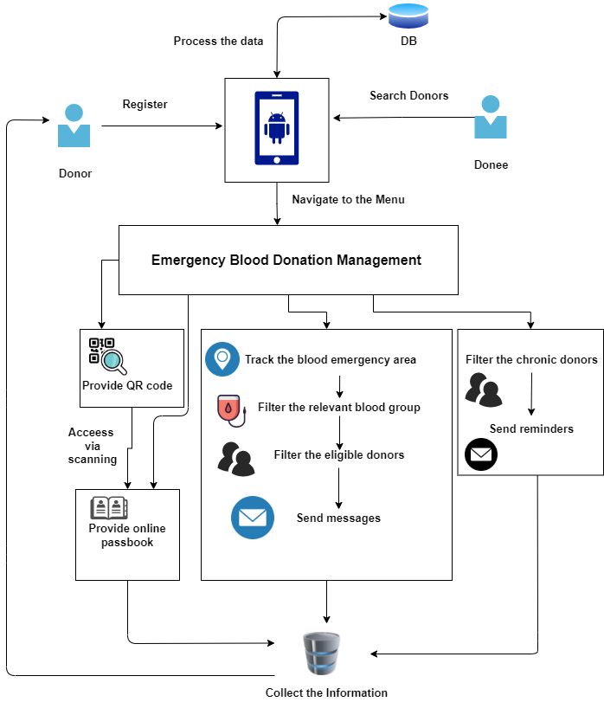
System Diagram
IT19115108 | Malkanthi.P.L
2022_311
IT18212150 | T.D. BALASOORIYA

Slide 60
Technologies
Programming Language
Python, JavaScript
Libraries
Firebase
Technology
Image Processing
K mean algorithm
IT19115108 | Malkanthi.P.L
2022_311
IT18212150 | T.D. BALASOORIYA

Slide 61
Requirements
User Requirements
Should track the eligible donors via using google map when in blood emergency
Need to be able to access the Passbook by using the QR code and update the information correctly
Should send reminders to chronic donors every 4months
System requirements (For implementation)
4GB or greater memory.
IT19115108 | Malkanthi.P.L
2022_311
IT18212150 | T.D. BALASOORIYA

Slide 62
Requirements Cont’d
Software Specific Requirements
Functional
Login
Registration
Filtering the eligible donors when in emergency incident
Send messages to eligible donors, tracking the google map
Come up with QR code for each of registered donor
Every 4 months, send reminder to chronic blood donors
Non functional
Availability
Security & Privacy
Performance
IT19115108 | Malkanthi.P.L
2022_311
IT18212150 | T.D. BALASOORIYA

Slide 63
Work Breakdown Structure
IT19115108 | Malkanthi.P.L
2022_311
IT18212150 | T.D. BALASOORIYA

Slide 64
Supportive information
IT19115108 | Malkanthi.P.L
2022_311
IT18212150 | T.D. BALASOORIYA

Slide 65
Commercialization
User benefits
In case of an emergency, the connection between Donor and Blood Bank can be successfully maintained through the Blood Donation Application
It is possible to maintain the information in the passbook properly using the code
In the industries
This supports people in saving time and increasing productivity
IT19115108 | Malkanthi.P.L
2022_311
IT18212150 | T.D. BALASOORIYA

Slide 66
References
[1] S. N. Diba, “Blood Donation Application with Implementation of Machine Learning,” no. April, 2018.
[2] L. Sardi, A. Idri, and J. L. Fernández-Alemán, “Gamified mobile blood donation applications,” Lect. Notes Comput. Sci. (including Subser. Lect. Notes Artif. Intell. Lect. Notes Bioinformatics), vol. 10208 LNCS, pp. 165–176, 2017, doi: 10.1007/978-3-319-56148-6_14.
[3] A. A. Batis and A. Albarrak, “Preferences and features of a blood donation smartphone app: A multicenter mixed-methods study in Riyadh, Saudi Arabia,” Comput. Methods Programs Biomed. Updat., vol. 1, no. February, p. 100005, 2021, doi: 10.1016/j.cmpbup.2021.100005.
[4] S. Ahdan and S. Setiawansyah, “Android-Based Geolocation Technology on a Blood Donation System (BDS) Using the Dijkstra Algorithm,” IJAIT (International J. Appl. Inf. Technol., vol. 5, no. 01, p. 1, 2021, doi: 10.25124/ijait.v5i01.3317.
IT19115108 | Malkanthi.P.L
2022_311
IT18212150 | T.D. BALASOORIYA

Slide 67
Work Distribution

Slide 68
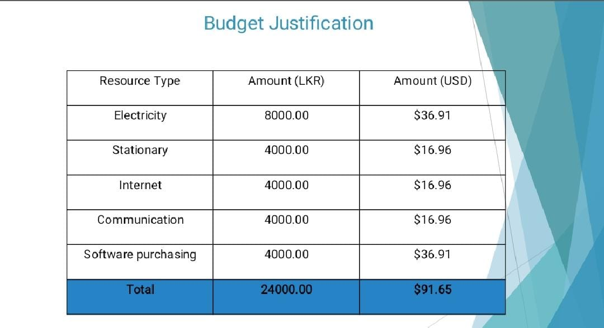
Budget

Slide 69

2022_311

Slide 70

Questions?

